Slide 1
Exploratory Data Analysis (EDA)
Using statistical tools, describe main features of data.
First, univariate analysis: examine each variable by itself. Then describe relationships among variables.
Begin with graphs. Then add numerical summaries.

Slide 2
Categorical Data
Graphs: Bar charts, pie charts
Frequency tables, relative frequency tables, percentage tables.

Slide 3
Quantitative Data
Examples:
Who, What, When, Where, Why
Toyota Line (city mpg, 2009)
MA hospital birth weights

Slide 4
5W’s: Who? What? When? Where? Why?
7 115 68 459 5031 671 336 121 47 1143 765 264 121 67 504 206 182 105 89 586 591 156 417 327 402 55 42 569 19 77 109 279 70 243 1157 412 62 616 419 86 237 33 417 1137 203 547 208 878 284 87 47
Table 1. A data set of 51 numbers.

Slide 5
5W’s Answered
Who? Individuals or subjects: States and DC
What? Number of public electric vehicle charging stations
Where? Across the U.S.
When? As of the end of 2018
Why? My niece has an electric car and I was curious about how hard it would be to drive across the country.
https://afdc.energy.gov/data_download

Slide 6
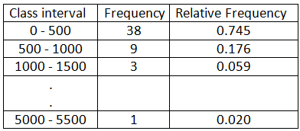
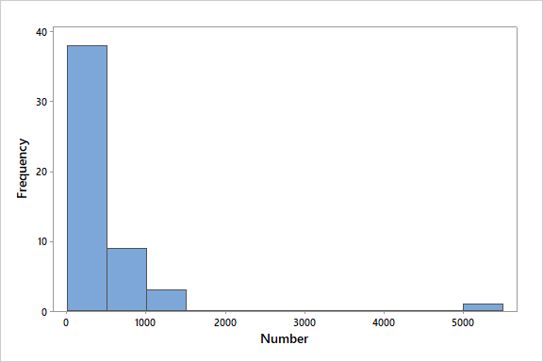
Histogram
Class intervals

Slide 7
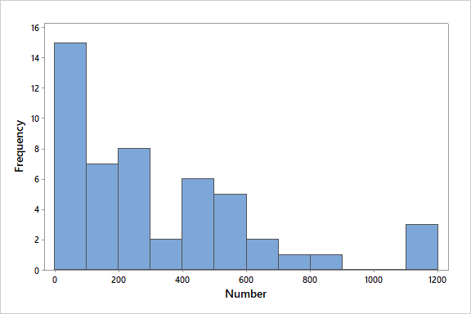
Remove Extreme Outlier: CA Don’t take first graph you get – experiment to see if you can learn more. Allows me to reduce the width of the class intervals.
Less extreme possible outliers: FL, TX, NY
Middle valley: CT, MN
Bimodal: What’s the story? Any explanations?

Slide 8
Toyota Line, Citympg (2009)
19 21 21 19 33 22 21 18 28 26 26 25 48 29 29 17 16 15 14 14 13 13 16 15 16 14 16 18 27 27 13 21 19 20 19 14 14 13 13
Organize and display data: stem-and-leaf plot
First, by hand and then use R.
Note: R is case sensitive: To R, Citympg and citympg are different!!!!

Slide 9
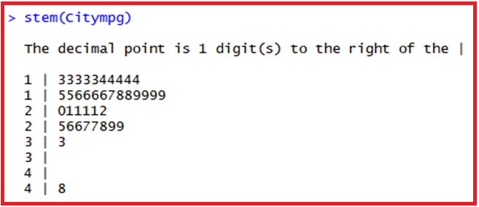
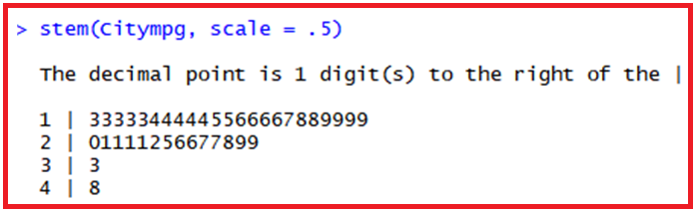
Stem-and-Leaf Plot

Slide 10
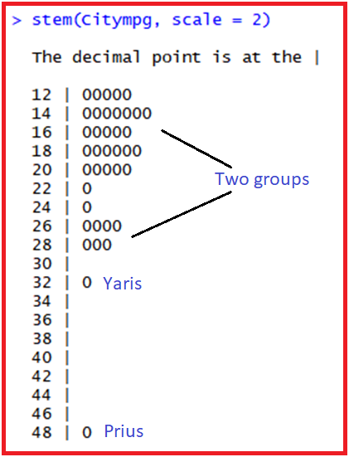
Expanding the Stem What Problem do you encounter?

Slide 11
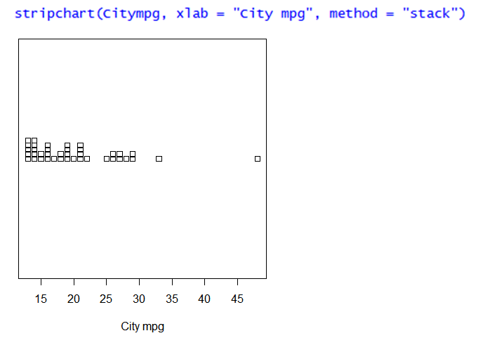
Dotplot

Slide 12
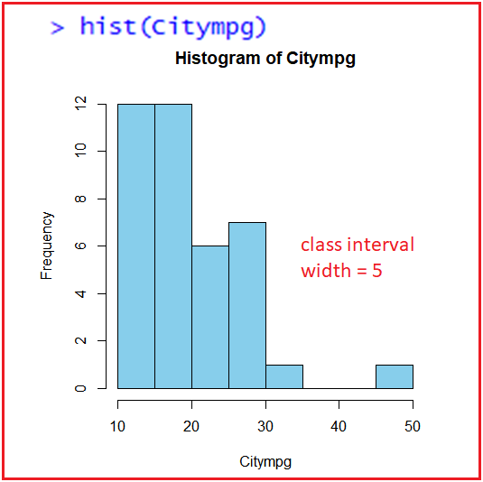


Histogram: Summarizing the Data

Slide 13
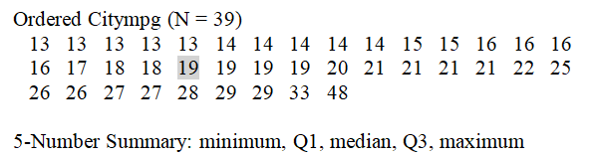
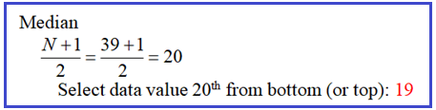
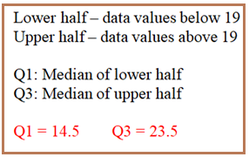

five-number summary

Slide 14
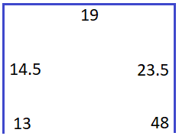


John Tukey: 5-number summary Location, Spread, Shape

Slide 15
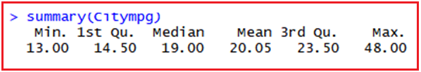

R’s summary()

Slide 16
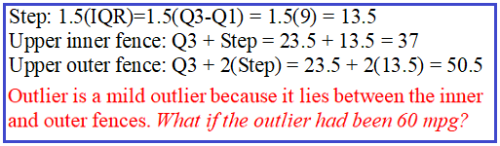
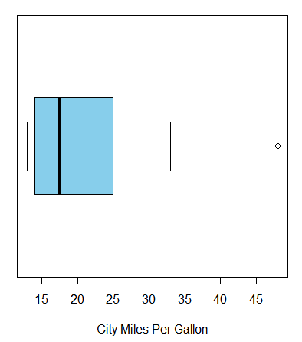
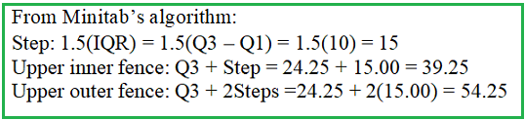
Box-and-Whisker Plot

Slide 17


Mean and Standard Deviation

Slide 18
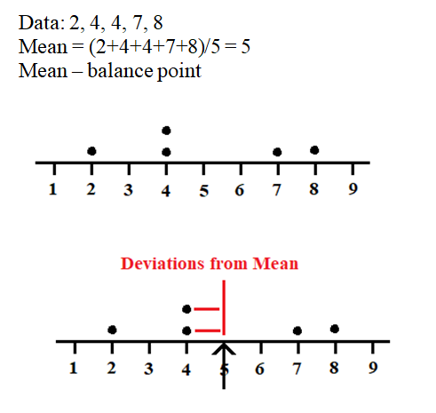



Slide 19
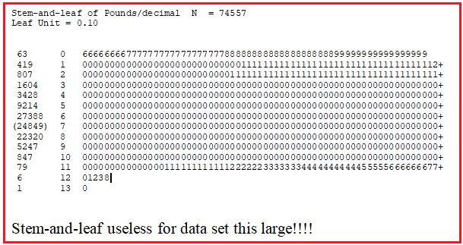
MA Birthweights (pounds) Minitab Output

Slide 20
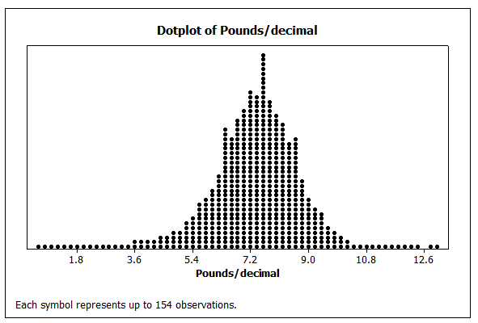

Slide 21
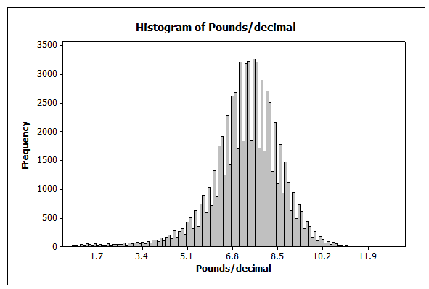
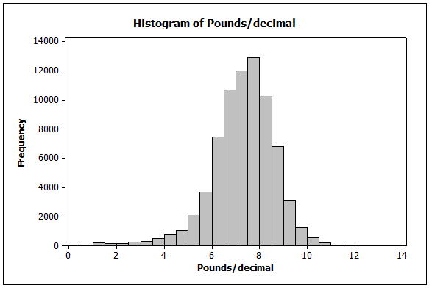

Slide 22
